Slide 1
Car Crash Analysis
Aditya Satam MT2020058
Mohit Choudhary MT2020134
Shubham Ahlawat MT2020163

Slide 2
Content
1. Understanding Source Dataset
2. Initial Cleanup of the data
3. EDA Observations
4. Top States and Top Cities with most accidents
5. Analyze accident trends over time series

Slide 3
6. Analyze accident severity levels
7. Evaluate Weather Conditions effect on accidents
8. Analyze accidents occurring streets over its severity
9. Spatial Analysis of Accidents on the map
10. Predict total no. of accidents in different states for future dates
using different supervised learning techniques.

Slide 4
Background
The accident datasets collected using two APIs that provide streaming traffic incident data.
These APIs broadcast traffic data captured by a variety of entities, such as state departments of transportation, law enforcement agencies, traffic cameras and traffic sensors within the road-networks.
Accidents can be used for various applications such as real-time car accident prediction, studying car accidents hotspot locations, casualty analysis and extracting cause and effect rules to predict car accidents.

Slide 5
Objectives
1. To identify top States and top Cities with most accidents.
2. To analyze accident trends over time series.
3. To find temporal data for most of the accidents.
4. To analyze change in accident severity levels over the years.
5. To evaluate Weather Conditions effect on accidents.

Slide 6
6. To analyze accidents occurring streets over its severity.
7. To spatial analyze accidents on the map.
8. To predict total no. of accidents in different states for future dates
using different techniques.

Slide 7

Understanding Source Dataset:
There is one .csv file “Accidents.csv“ with 2M rows and 49 columns i.e. 17 String, 13 Boolean, 12 Decimal and 7 Others.
ID: unique identifier of accident record.
Source: Indicates source/API of the accident report.
TMC: Traffic Message Channel code which provides more detailed description of the event.
Severity: a number between 1 and 4, where 1 indicates least impact on traffic and 4 indicates a significant impact on traffic.
.

Slide 8
Start_Lat: Shows latitude in GPS coordinate of the start point.
Start_Lng: Shows longitude in GPS coordinate of the start point.
End_Lat: Shows latitude in GPS coordinate of the end point.
End_Lng: Shows longitude in GPS coordinate of the end point.

Slide 9
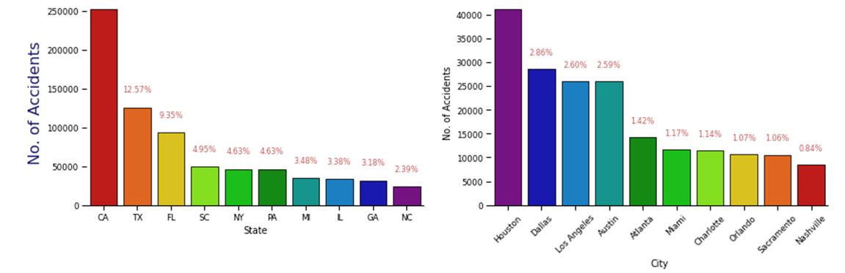
top States and top Cities with most accidents

Slide 10
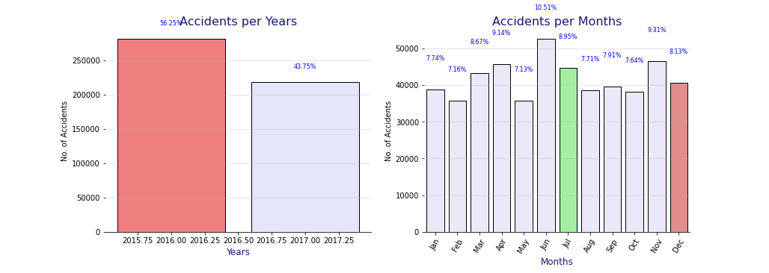
Accident trends over time series

Slide 11
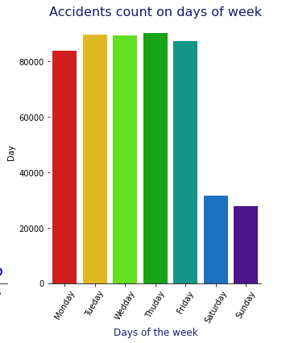

Slide 12
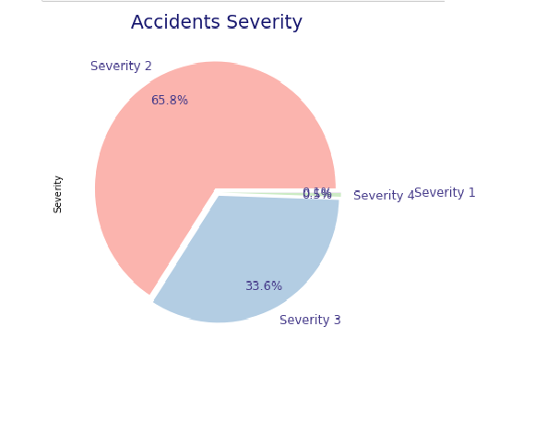
Accident severity levels analysis

Slide 13
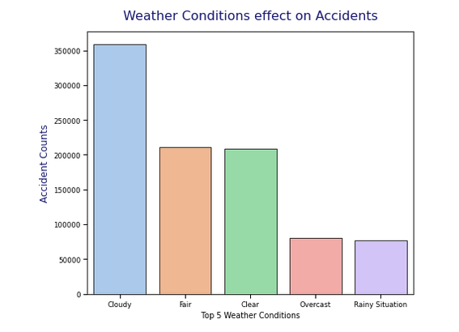
Weather Conditions effect on accidents

Slide 14
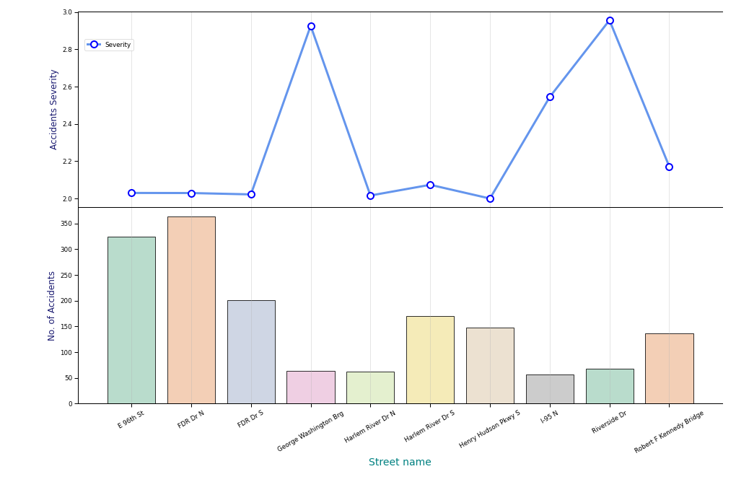
Most accidents occurring streets vs. its severity

Slide 15
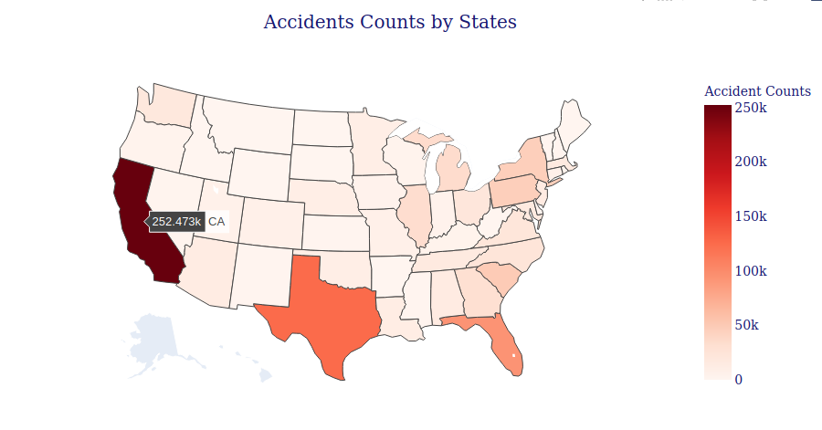
Spatial Analysis of Accidents on the map

Slide 16
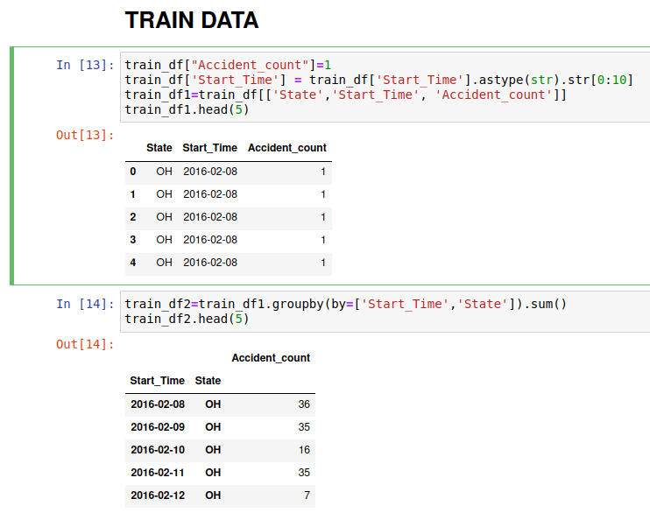
Create Train data frame

Slide 17
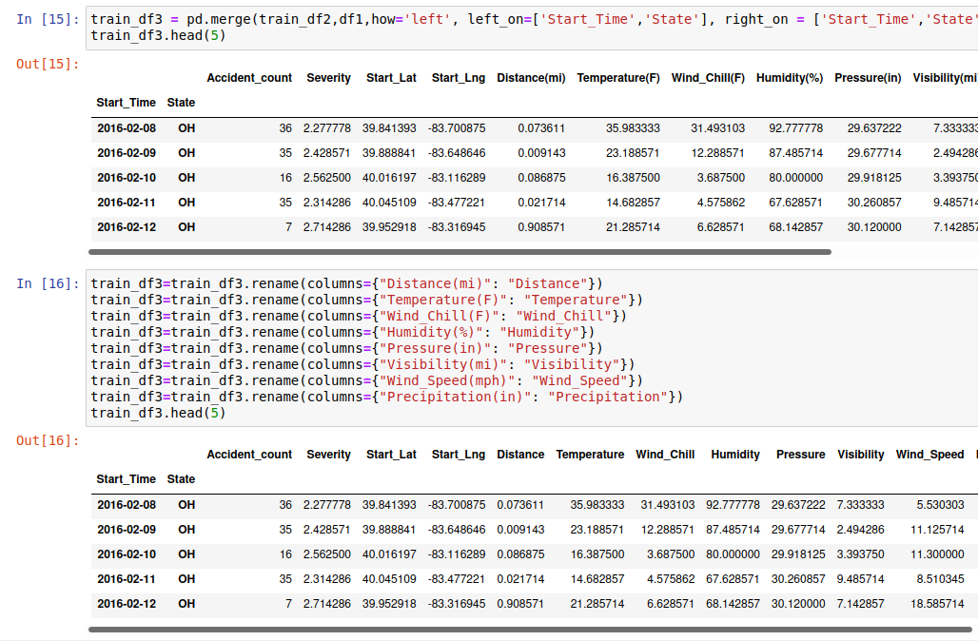
Add & rename columns to Train data

Slide 18
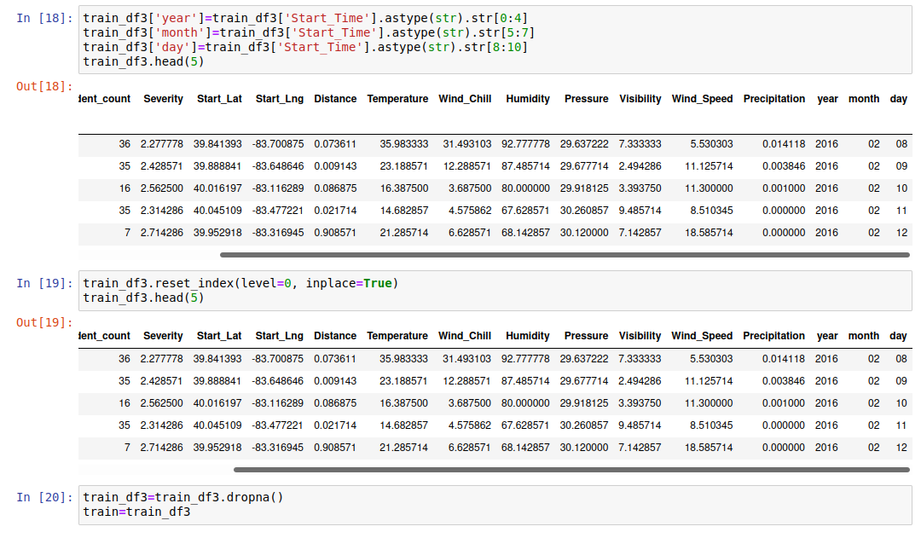
Create year, month, date columns & handle null values in Train data

Slide 19
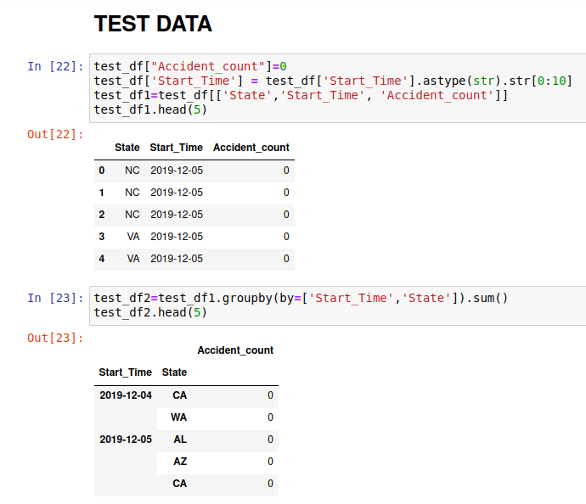
Create Test data frame

Slide 20
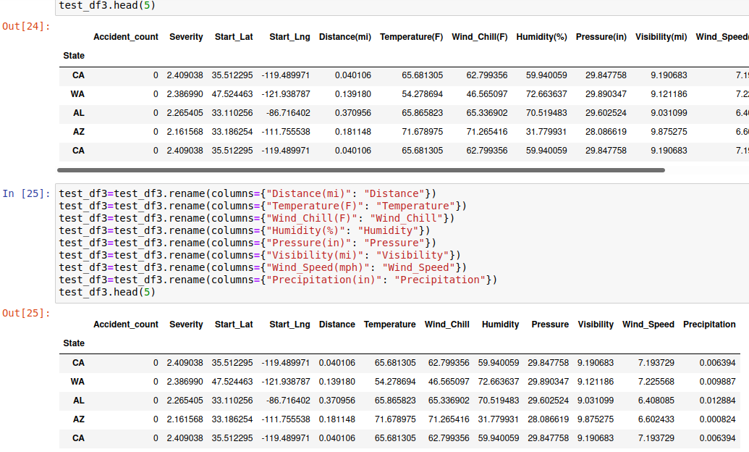
Add & rename columns to Test data

Slide 21
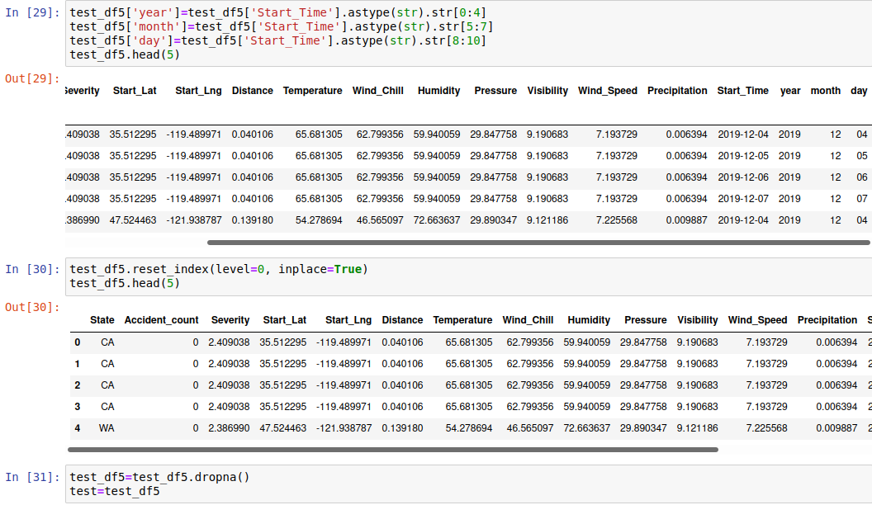
Create year, month, date columns & handle null values in Test data

Slide 22
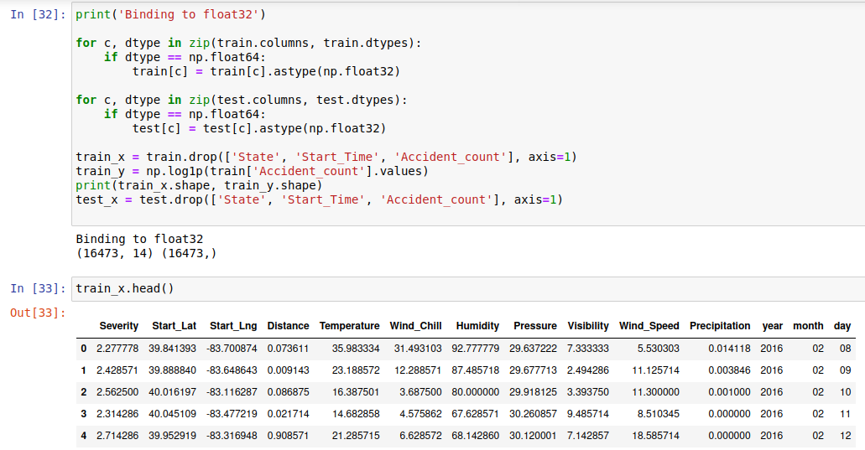
Binding to Train & Test data to float32 data type

Slide 23
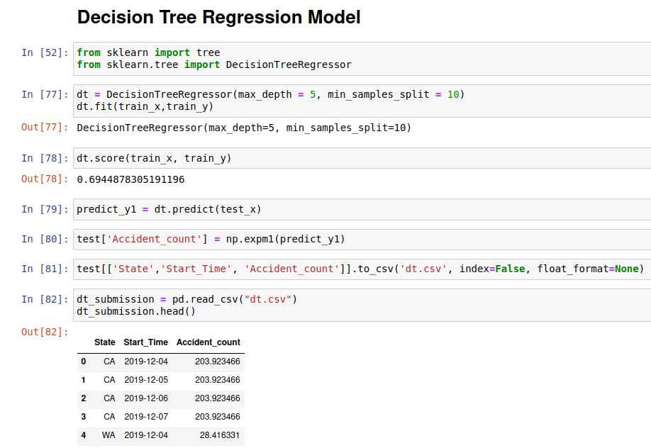
Supervised learning algorithms

Slide 24
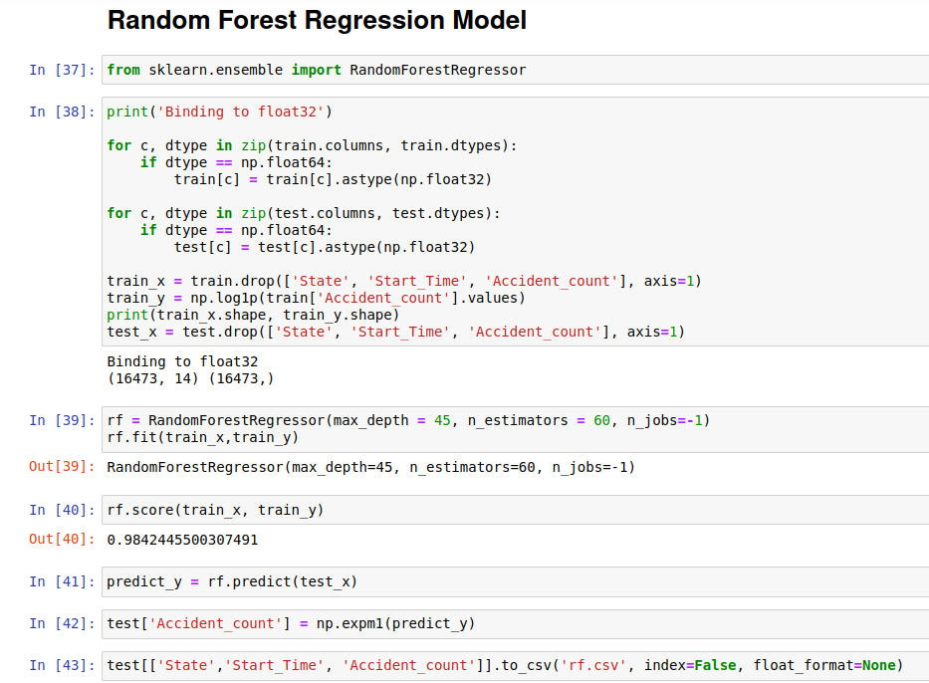
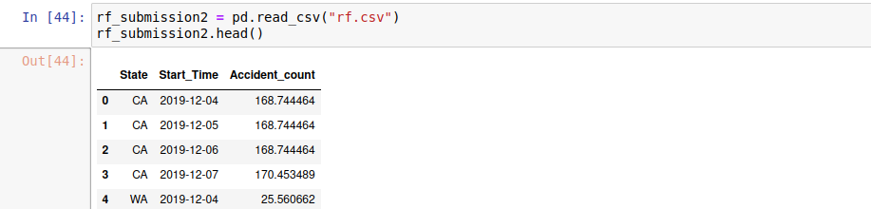

Slide 25
Research Questions
1. Is there a change in accident severity levels over the years ?
2. Do Weather Conditions have effect on Accidents ?

Slide 26

Thank You

